Slide 1



Project1:
Tone-Vocoder
12011622 赵瑞州 12012926 雷其融
12013001 李显涵 12013003 冯浩林

Slide 2
C
ONTENTS
01/Introduction
02/presentation
03/Discussion
04/Q＆A

Slide 3
01
Introduction

Slide 4
Team ＆ Individual Contribution
赵瑞州
25%
雷其融
25%
Task 1-4 Code ＆ Discussion
Task 1-4 Analysis ＆ PowerPoint
李显涵
25%
冯浩林
25%
Tone-vocoder function ＆ Lab Report
Problem Research & PowerPoint

Slide 5
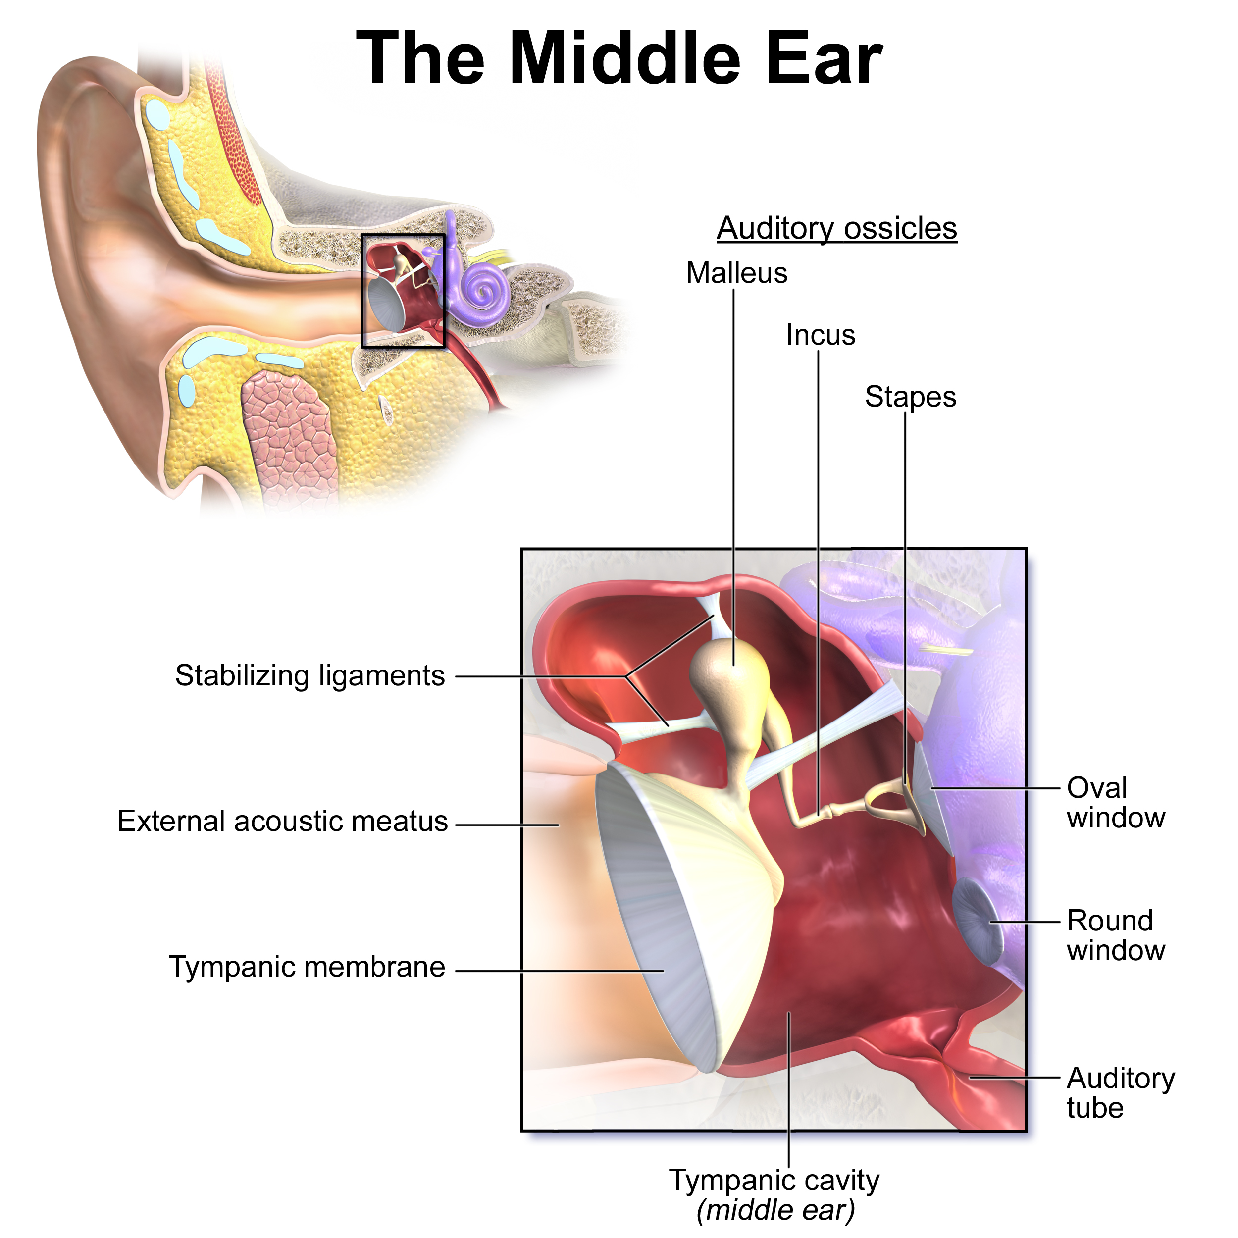
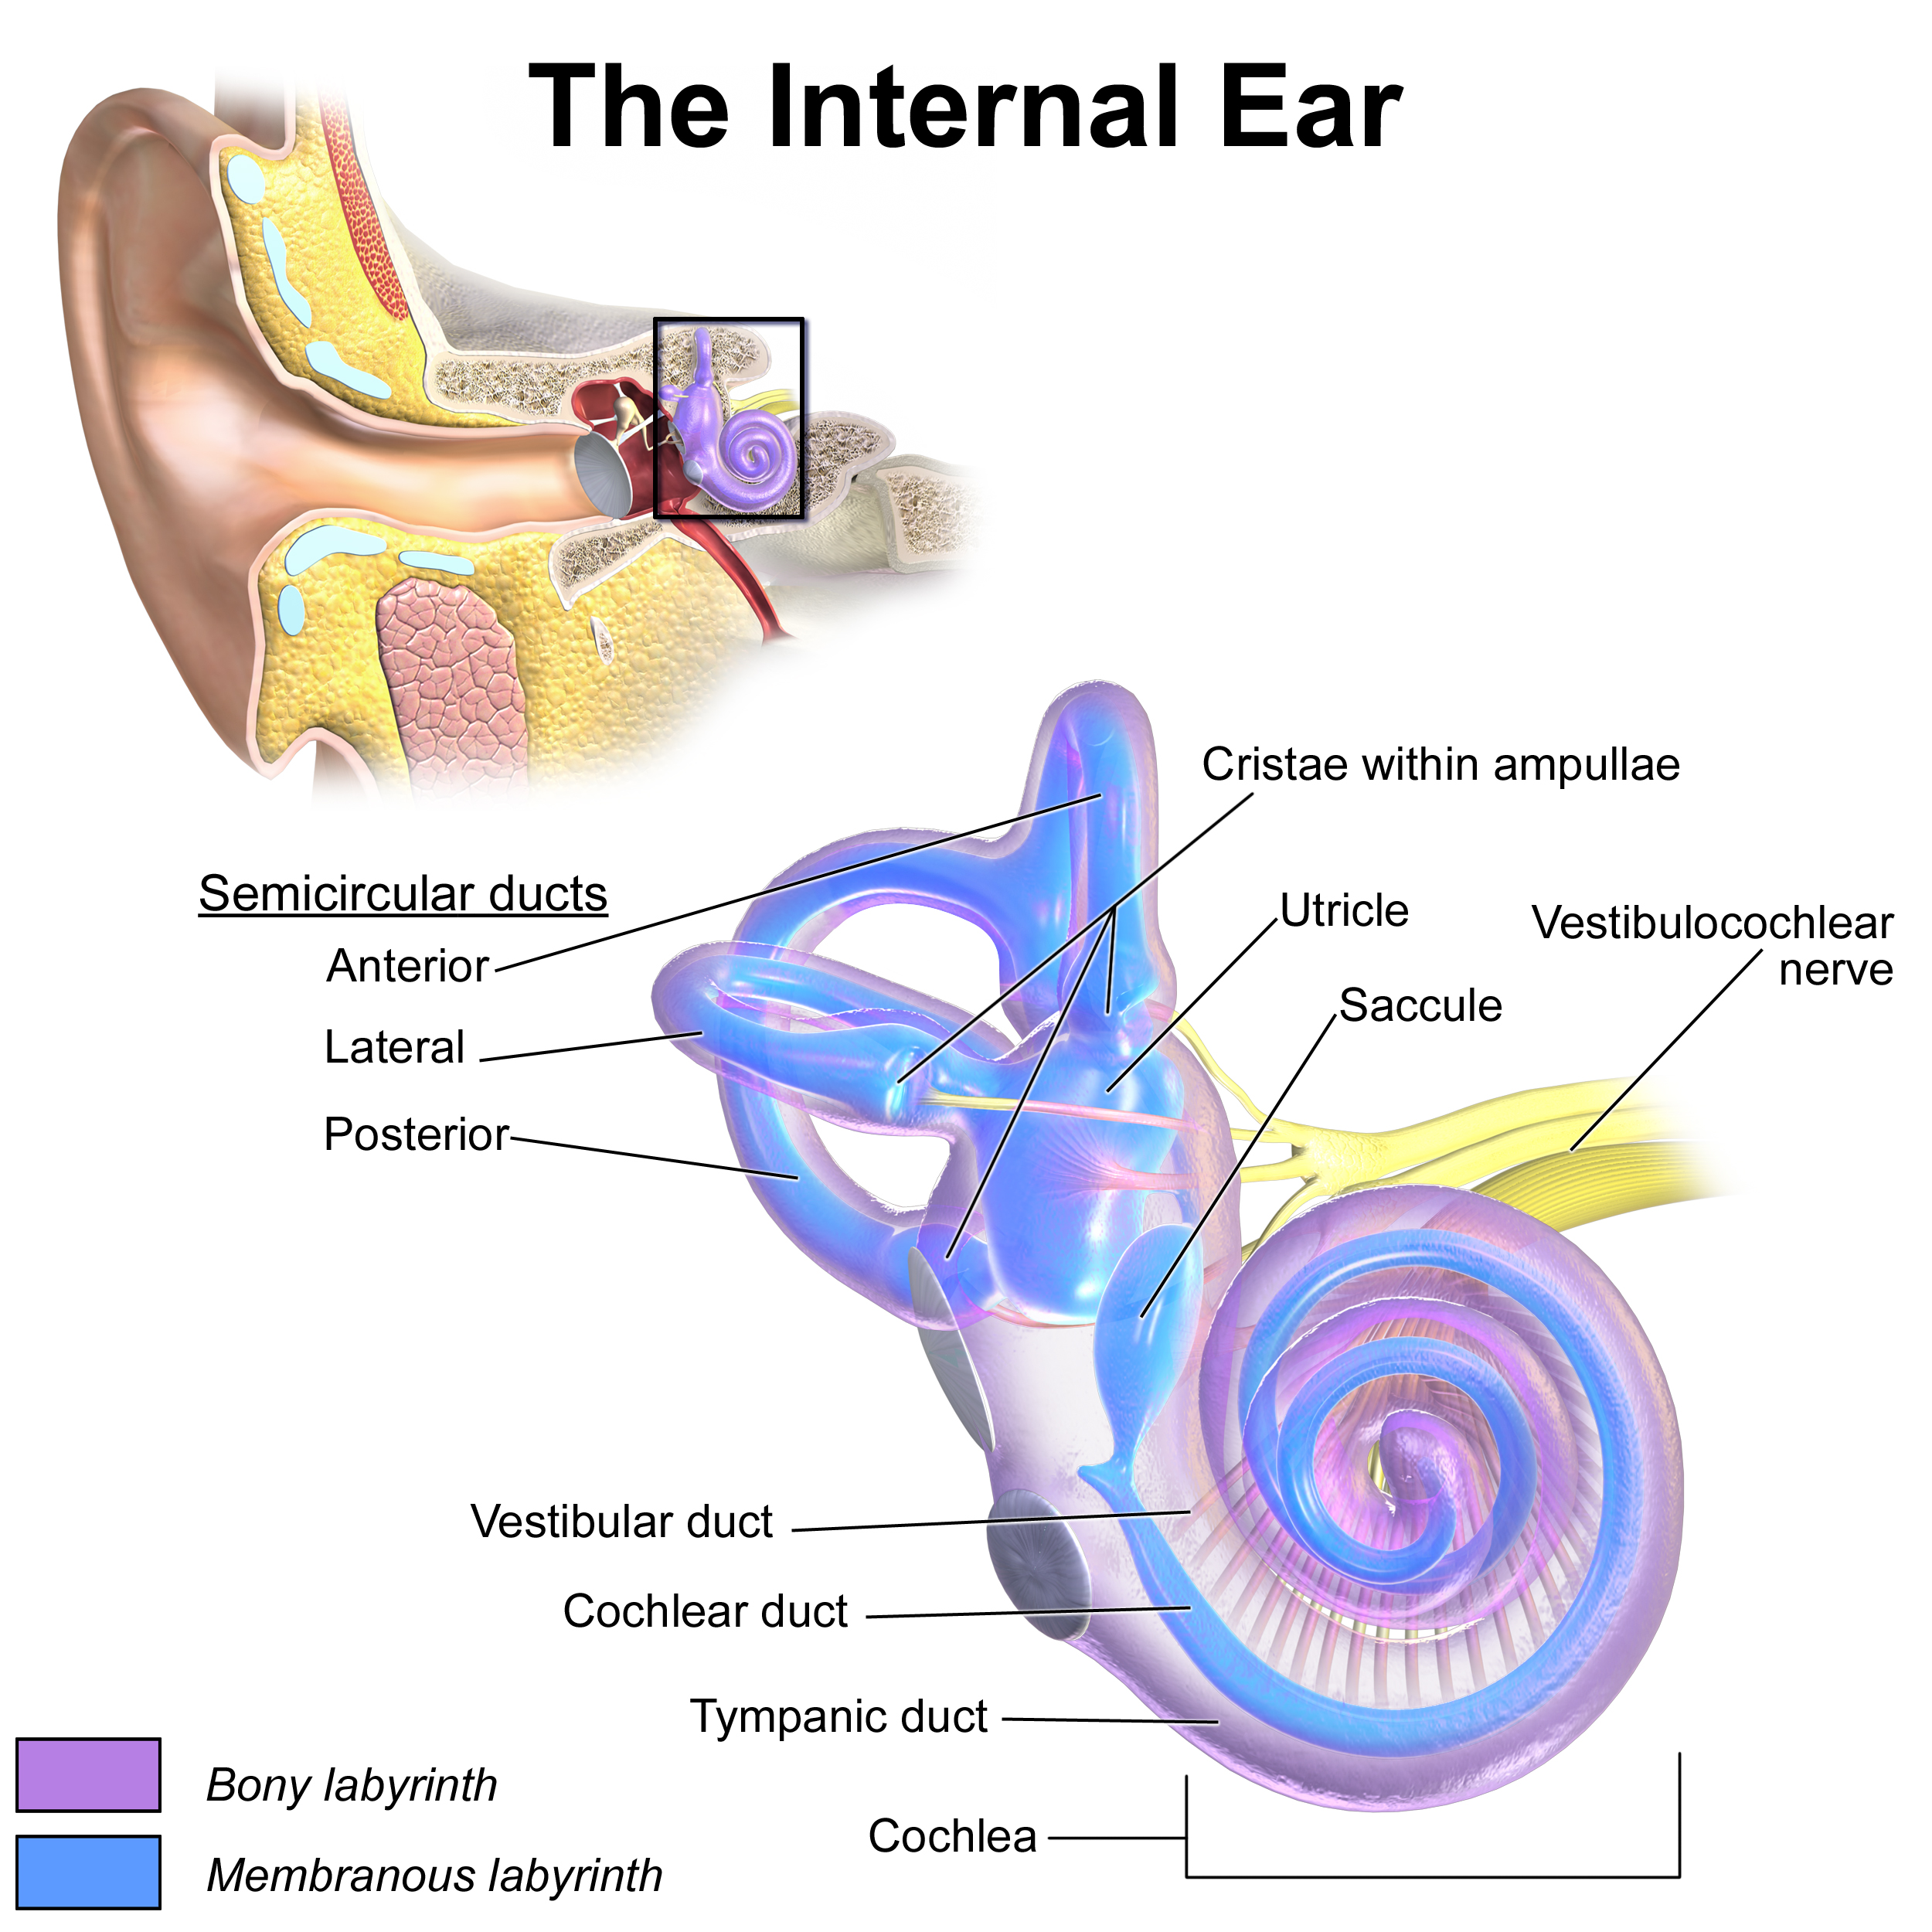
Sound Forming

Slide 6
Deafness
1
2
3
Conductive Hearing
Loss
Sensorineural Hearing Loss
Mixed Hearing Loss
90%
over 70 : ~50%
More than 16% in China!!
cochlear impant
Hearing aid

Slide 7
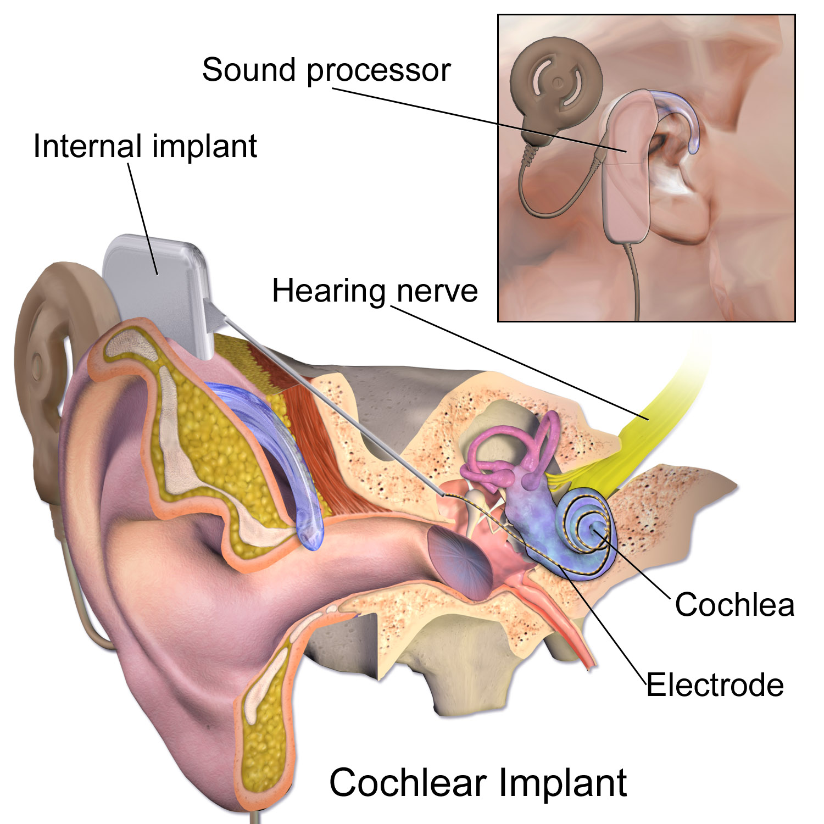
Cochlear Implant
WHAT IS TICI?
Parts:
one or more microphones
a speech processor
a transmitter
a receiver/stimulator
an electrode array

Slide 8
Objective of the project
Simulating cochlear implant signal processing
Exploring how the number of bands and the LPF cutoff frequency affect the intelligibility in the case of processing a pure speech signal and a noisy signal

Slide 9
Methodology
1.Create a Function to simulate cochlear implant signal processing
2.Generate the amplitude figure, fft figure and psd figure in each task, and compare the figures of different the number of bands or the LPF cutoff frequency
3.Compare the figures of task 1 and 3, 2 and 4, to find some differences between the pure signal and noisy signal

Slide 10
02
Presentation

Slide 11

02/Presentation
Leadfunction: tonevocoder
Task 01
Task 02
Task 03
Task 04

Slide 12
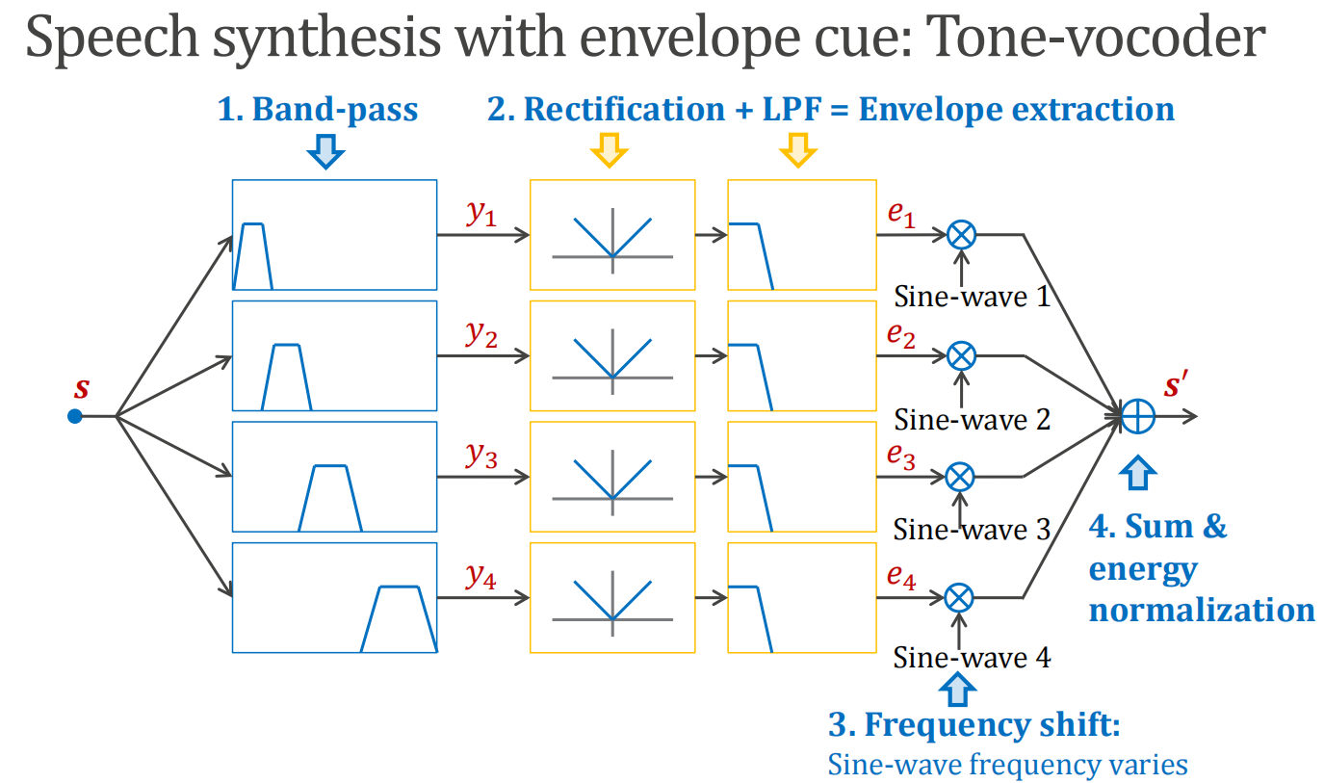
Lead function:tonevocoder

Slide 13
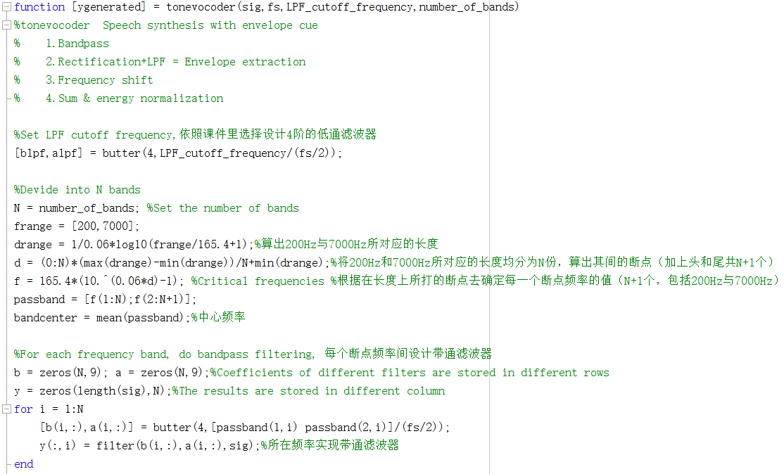
Lead function:tonevocoder
等分距离，并用距离断点推算出频率断点（包括头尾N+1个），并算出每个band的中心频率
设计并实现每个频率段的带通滤波器

Slide 14
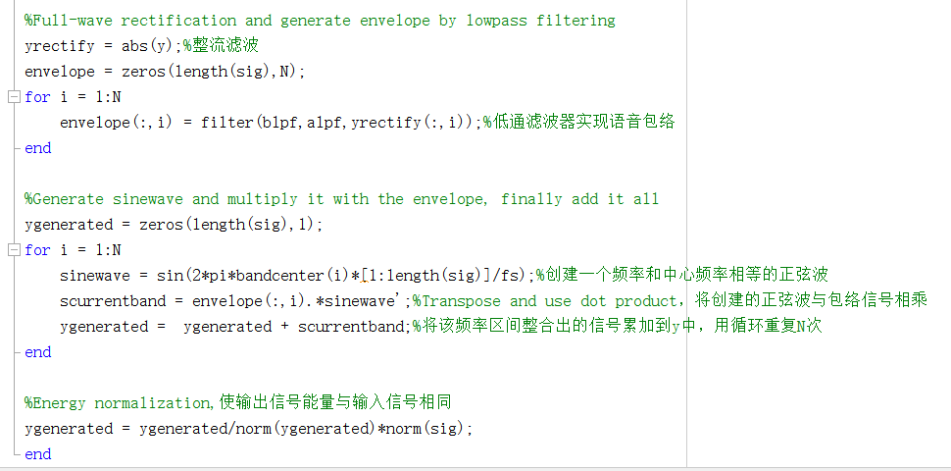
Lead function:tonevocoder
对每个频率段信号实现整流滤波，用低通滤波器实现包络
构建每个中心频率的正弦波，并于包络信号相乘，逐个叠加
能量归一化

Slide 15
Task1 Problem
• Set LPF (for envelop extraction) cutoff frequency to 50 Hz.
• Implement tone-vocoder by changing the number of bands to 𝑁= 1, 𝑁= 2, 𝑁= 4, 𝑁= 6, and 𝑁= 8. (bandpass filters vary)
• Save the wave files for these conditions, and describe how the number of bands affects the intelligibility (i.e., how many words can be understood) of synthesized sentence.

Slide 16

Task1 Analysis
Waveform
N=1
N=2
N=4
N=6
N=8

Slide 17
Task1 Analysis
FFT Figure and PSD figure

Slide 18
Task1 Analysis
分析以上可以看出，随着频段数目的增加其可读性也会增加，与原信号更加接近。
但是，在task1中我们选取的N从1，2，4，6到8时，我们只能听清楚一个模糊大概的音频，仍然无法具体听清楚其准确的信息。
我们猜想可能是N到值仍然不够大所致。即在一定范围内，随着频段N的值增加，所得音频也会更加清晰。并且N过大时会出现失真。

Slide 19
Task2 Problem
• Set the number of bands 𝑁= 4.
• Implement tone-vocoder by changing the LPF cutoff frequency to 20 Hz, 50 Hz, 100 Hz, and 400 Hz.
• Describe how the LPF cutoff frequency affects the intelligibility of synthesized sentence.

Slide 20
Task2 Analysis
Waveform
f=20Hz
f=50Hz
f=100Hz
f=400Hz

Slide 21
Task2 Analysis
FFT Figure and PSD figure

Slide 22
Task2 Analysis
分析以上图像可以看出，N=4截止频率从20Hz，50Hz，100Hz到400Hz时，随着LPF截止频率的增加，合成信号的可读性增加，依次变得更加清晰，也与原信号更加接近。其中，LPF截止频率为20Hz，50Hz和100Hz时，信号的可读性增加不明显，仍然难以听清，但400Hz时有明显增加，可以依稀听清原信号的内容。
继续增大截止频率，信号也会继续变得清晰。发现增加LPF截止频率大于4000Hz时，与原信号相比出现失真。

Slide 23
Task3 Problem
• Generate a noisy signal (summing clean sentence and SSN) at SNR −5 dB.
• Set LPF cut-off frequency to 50 Hz.
• Implement tone-vocoder by changing the number of bands to 𝑁= 2, 𝑁= 4, 𝑁= 6, 𝑁= 8, and 𝑁= 16.
• Describe how the number of bands affects the intelligibility of synthesized sentence, and compare findings with those obtained in Task 1.

Slide 24
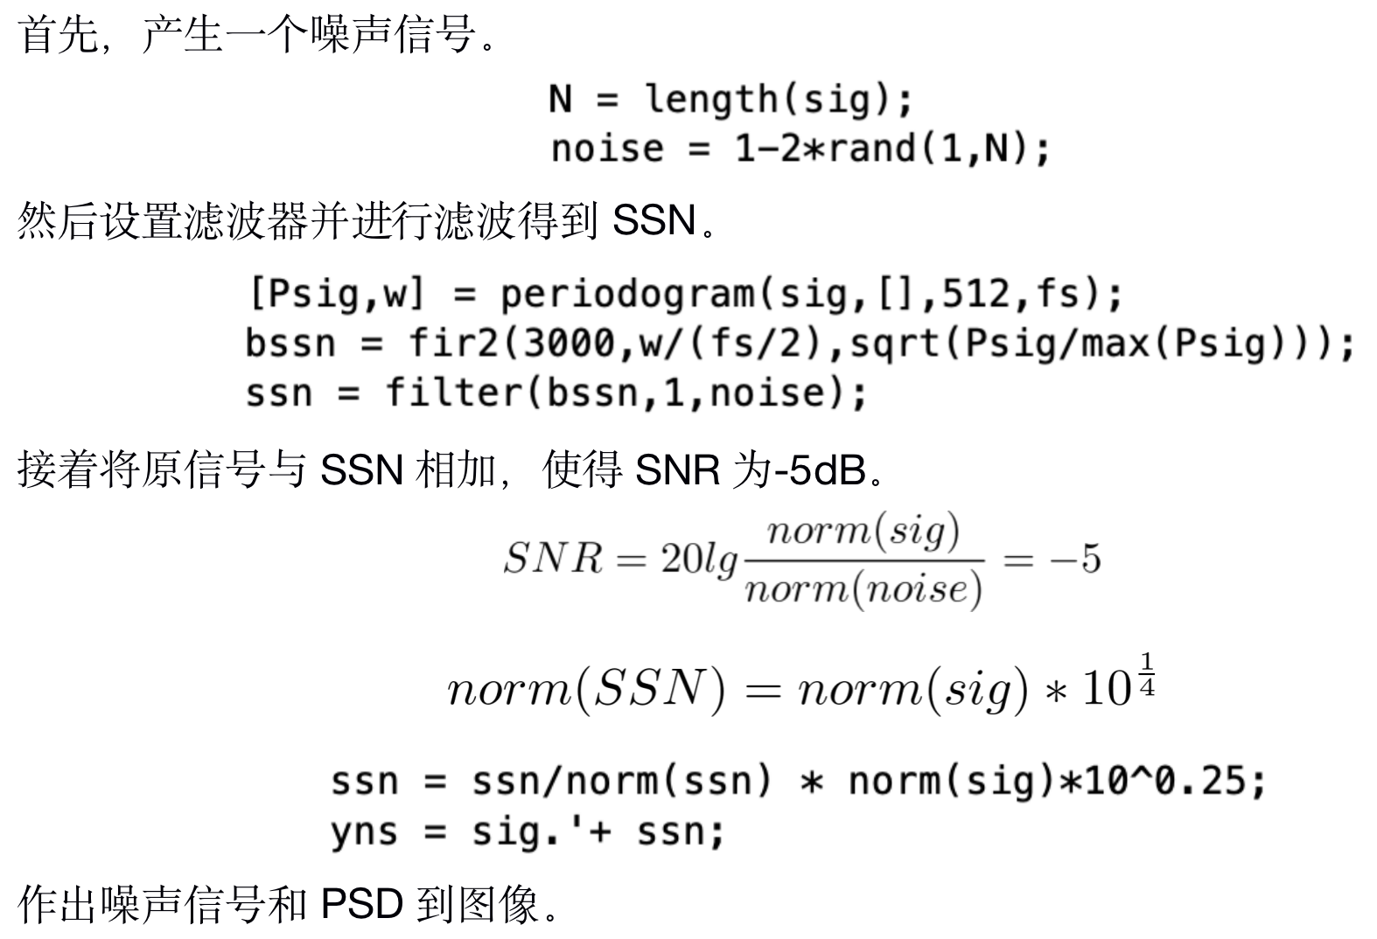
Task3 Analysis

Slide 25
Task3 Analysis
Waveform
N=2
N=4
N=6
N=8
N=16

Slide 26
Task3 Analysis
FFT Figure and PSD figure

Slide 27
Task3 Analysis
由图像以及音频可知，随着频段数目的增加其可读性也会增加，与原信号更加接近。
N相同时，task3中最终的信号可读性不如task1中的好。由于加上噪声信号后，尽管进行了一系列处理，噪声信号并没有消除，仍然为一种噪音存在于音频中，对于原语音信号可读性有影响。
同样的，在一定范围内，随着频段N的值增加，所得音频也会更加清晰。并且N过大时会出现失真。

Slide 28
Task4 Problem
• Generate a noisy signal (summing clean sentence and SSN) at SNR −5 dB.
• Set the number of bands to 𝑁= 6.
• Implement tone-vocoder by changing the LPF cut-off frequency to 20 Hz, 50 Hz, 100 Hz, and 400 Hz.
• Describe how the LPF cut-off frequency affects the intelligibility of synthesized sentence.

Slide 29
Task4 Analysis
Waveform
f=20Hz
f=50Hz
f=100Hz
f=400Hz

Slide 30
Task4 Analysis
FFT Figure and PSD figure

Slide 31
Task4 Analysis
N=6时随着LPF截止频率从20Hz增加到400Hz，合成信号到可读性增加，逐渐变得清晰。其中LPF截止频率为20Hz，50Hz和100Hz时，信号的可读性增加不明显，并且可读性仍然不高，但400Hz以后有明显增加，可以大概听清原信号但内容。
与task2相比，截止频率相同时，由于噪声的影响，task4不如task2中清晰，对可读性产生了影响。
继续增大截止频率，信号也会继续变得清晰。直到增加LPF截止频率大于4000Hz时，与原信号相比出现失真。

Slide 32
%Full-wave rectification and generate envelope by lowpass filtering
yrectify = abs(y);
envelope = zeros(length(sig),N);
for i = 1:N
envelope(:,i) = filter(blpf,alpf,yrectify(:,i));
subplot(N,3,(3*i-1));
plot(envelope(:,i) );xlabel('Samples');ylabel('Envelope');axis([0,length(envelope(:,i)),0,max(envelope(:,i))]);
end
%Generate figures of bands of the output signal
for i = 1:N
sinewave = sin(2*pi*bandcenter(i)*[1:length(sig)]/fs);
scurrentband = envelope(:,i).*sinewave';%Transpose and use dot product
subplot(N,3,(3*i));
plot(scurrentband);xlabel('Samples');ylabel('Bands of the sound');
end
%Make title
if noise==1
if number_of_bands==1
sgtitle(['Figures with ' ,num2str(number_of_bands), ' band and LPF cut-off frequency ',num2str(LPF_cutoff_frequency),'Hz with noise']);
else
sgtitle(['Figures with ' ,num2str(number_of_bands), ' bands and LPF cut-off frequency ',num2str(LPF_cutoff_frequency),'Hz with noise']);
end
else
if number_of_bands==1
sgtitle(['Figures with ' ,num2str(number_of_bands), ' band and LPF cut-off frequency ',num2str(LPF_cutoff_frequency),'Hz']);
else
sgtitle(['Figures with ' ,num2str(number_of_bands), ' bands and LPF cut-off frequency ',num2str(LPF_cutoff_frequency),'Hz']);
end
end
end
Task1-4 Code
graphmaker
function [] = graphmaker(sig,fs,LPF_cutoff_frequency,number_of_bands,noise)
%Make graphs of tonevocoder Speech synthesis with envelope cue
%Set LPF cutoff frequency
[blpf,alpf] = butter(4,LPF_cutoff_frequency/(fs/2));
%Divide into N bands
N = number_of_bands; %Set the number of bands
frange = [200,7000];
drange = 1/0.06*log10(frange/165.4+1);
d = (0:N)*(max(drange)-min(drange))/N+min(drange);
f = 165.4*(10.^(0.06*d)-1); %Critical frequencies
passband = [f(1:N);f(2:N+1)];
bandcenter = mean(passband);
%For each frequency band, do bandpass filtering
b = zeros(N,9); a = zeros(N,9);%Coefficients of different filters are stored in different rows
y = zeros(length(sig),N);%The results are stored in different column
for i = 1:N
[b(i,:),a(i,:)] = butter(4,[passband(1,i) passband(2,i)]/(fs/2));
y(:,i) = filter(b(i,:),a(i,:),sig);
subplot(N,3,(3*i-2));
plot( y(:,i) );xlabel('Samples');ylabel('Amplitude');
end

Slide 33
Taskcode
Task1
figure(2);
subplot(3,2,1);plot(w0,20*log10(Pxx0));xlabel('frequency/Hz');ylabel('psd/dB');title('original');
subplot(3,2,2);plot(w1,20*log10(Pxx1));xlabel('frequency/Hz');ylabel('psd/dB');title('N=1');
subplot(3,2,3);plot(w2,20*log10(Pxx2));xlabel('frequency/Hz');ylabel('psd/dB');title('N=2');
subplot(3,2,4);plot(w4,20*log10(Pxx4));xlabel('frequency/Hz');ylabel('psd/dB');title('N=4');
subplot(3,2,5);plot(w6,20*log10(Pxx6));xlabel('frequency/Hz');ylabel('psd/dB');title('N=6');
subplot(3,2,6);plot(w8,20*log10(Pxx8));xlabel('frequency/Hz');ylabel('psd/dB');title('N=8');
[sig,fs] = audioread('C_01_01.wav');%read the signals
LPF_cutoff_frequency=50;%set the cut-off frequency to 50 Hz
N = length(sig);
f = fs*(-N/2:N/2-1)/N;
ygenerated1_1 = tonevocoder(sig,fs,50,1);
ygenerated1_2 = tonevocoder(sig,fs,50,2);
ygenerated1_3 = tonevocoder(sig,fs,50,4);
ygenerated1_4 = tonevocoder(sig,fs,50,6);
ygenerated1_5 = tonevocoder(sig,fs,50,8);
%% To get psd
[Pxx0,w0] = pwelch(sig,[],[],1024,fs);
[Pxx1,w1] = pwelch(ygenerated1_1,[],[],1024,fs);
[Pxx2,w2] = pwelch(ygenerated1_2,[],[],1024,fs);
[Pxx4,w4] = pwelch(ygenerated1_3,[],[],1024,fs);
[Pxx6,w6] = pwelch(ygenerated1_4,[],[],1024,fs);
[Pxx8,w8] = pwelch(ygenerated1_5,[],[],1024,fs);
%% plot ? ?
figure(1);
subplot(3,2,1);plot(f,fftshift(abs(fft(sig'))));xlabel('frequency/Hz');ylabel('sig Amp');title('original')
subplot(3,2,2);plot(f,fftshift(abs(fft(ygenerated1_1))));xlabel('frequency/Hz');ylabel('sig Amp');title('N=1')
subplot(3,2,3);plot(f,fftshift(abs(fft(ygenerated1_2))));xlabel('frequency/Hz');ylabel('sig Amp');title('N=2')
subplot(3,2,4);plot(f,fftshift(abs(fft(ygenerated1_3))));xlabel('frequency/Hz');ylabel('sig Amp');title('N=4')
subplot(3,2,5);plot(f,fftshift(abs(fft(ygenerated1_4))));xlabel('frequency/Hz');ylabel('sig Amp');title('N=6')
subplot(3,2,6);plot(f,fftshift(abs(fft(ygenerated1_5))));xlabel('frequency/Hz');ylabel('sig Amp');title('N=8')
Task3
[sig,fs] = audioread('C_01_01.wav');%read the signals
LPF_cutoff_frequency=50;%set the cut-off frequency to 50 Hz
f = fs*(-N/2:N/2-1)/N;
%Generate SSN
N = length(sig);
[Psig,w] = periodogram(sig,[],512,fs);
bssn = fir2(3000,w/(fs/2),sqrt(Psig/max(Psig)));
noise = 1-2*rand(1,length(bssn)+N);
ssn = filter(bssn,1,noise);
ssn = ssn((length(bssn)+1):end);
%Generate a noise signal at SNR=-5dB
ssn = ssn/norm(ssn) * norm(sig)*10^0.25;
yns = sig.'+ ssn;
ygenerated3_1 = tonevocoder(yns,fs,50,2);
ygenerated3_2 = tonevocoder(yns,fs,50,4);
ygenerated3_3 = tonevocoder(yns,fs,50,6);
ygenerated3_4 = tonevocoder(yns,fs,50,8);
ygenerated3_5 = tonevocoder(yns,fs,50,16);

Slide 34
%% To get psd
[Pxx0,w0] = pwelch(sig,[],[],1024,fs);
[Pxx1,w1] = pwelch(ygenerated3_1,[],[],512,fs);
[Pxx2,w2] = pwelch(ygenerated3_2,[],[],512,fs);
[Pxx3,w3] = pwelch(ygenerated3_3,[],[],512,fs);
[Pxx4,w4] = pwelch(ygenerated3_4,[],[],512,fs);
[Pxx5,w5] = pwelch(ygenerated3_5,[],[],512,fs);
%% plot ? ?
figure(1);
subplot(3,2,1);plot(f,fftshift(abs(fft(sig'))));xlabel('frequency/Hz');ylabel('sig Amp');title('original')
subplot(3,2,2);plot(f,fftshift(abs(fft(ygenerated3_1))));xlabel('frequency/Hz');ylabel('sig Amp');title('N=1')
subplot(3,2,3);plot(f,fftshift(abs(fft(ygenerated3_2))));xlabel('frequency/Hz');ylabel('sig Amp');title('N=2')
subplot(3,2,4);plot(f,fftshift(abs(fft(ygenerated3_3))));xlabel('frequency/Hz');ylabel('sig Amp');title('N=4')
subplot(3,2,5);plot(f,fftshift(abs(fft(ygenerated3_4))));xlabel('frequency/Hz');ylabel('sig Amp');title('N=6')
subplot(3,2,6);plot(f,fftshift(abs(fft(ygenerated3_5))));xlabel('frequency/Hz');ylabel('sig Amp');title('N=8')
figure(2);
subplot(3,2,1);plot(w0,20*log10(Pxx0));xlabel('frequency/Hz');ylabel('psd/dB');title('original');
subplot(3,2,2);plot(w1,20*log10(Pxx1));xlabel('frequency/Hz');ylabel('psd/dB');title('N=1');
subplot(3,2,3);plot(w2,20*log10(Pxx2));xlabel('frequency/Hz');ylabel('psd/dB');title('N=2');
subplot(3,2,4);plot(w3,20*log10(Pxx3));xlabel('frequency/Hz');ylabel('psd/dB');title('N=4');
subplot(3,2,5);plot(w4,20*log10(Pxx4));xlabel('frequency/Hz');ylabel('psd/dB');title('N=6');
subplot(3,2,6);plot(w5,20*log10(Pxx5));xlabel('frequency/Hz');ylabel('psd/dB');title('N=8');

Slide 35
03
Discussion

Slide 36
03/Discussion
80%
63%
75%
Critical Thinking
Investigation
Experience
investigation beyond project tasks
what we have learned from this study?

Slide 37
Critical Thinking
We can get the conclusion that the number of bands should not be increased infinitely. However, the result audio above with 𝑁 = 96 can be heard clearly, so when 𝑁 is around 96, it can lead to the best approximation of the original signal.

Slide 38
Critical Thinking
When we try to hear the result, we can find that those results with high LPF cutoff frequencies are mixed with sharp and peculiar sound. So, we can get the conclusion that the LPF cutoff frequency should not be increased infinitely. However, the result audio above with LPF cutoff frequency 600Hz can be heard clearly, so when LPF cutoff frequency is around 600Hz, it can lead to the best approximation of the original signal.

Slide 39
Investigation
50Hz, MaxN=110, 0.700487
100Hz, MaxN=110, 0.699456

Slide 40
Investigation
200Hz, MaxN=110, 0.697569
400Hz, MaxN=110, 0.696879

Slide 41
Investigation
800Hz, MaxN=114, 0.717241
We can clearly observe that the difference with just 1 band has influence the result tremendously, although we cannot figure out the reason, this discovery can help us to check the result we get above.
We stop to increase the LPF cutoff frequency here because higher LPF cutoff frequency will lead to distortion of the original signal.

Slide 42
Investigation
N=114，the LPF cut-off frequency:800Hz

Slide 43
Investigation
Summarize the conclusion we get in the tasks and our own additional investigation, the effect will be the best with number of bands around 114 , LPF cutoff frequency around 800Hz. To increase or decrease the two variables will lead to a negative effect. We also plot the figure of the result that is the most identifiable as following (𝑁 = 114 & LPF cutoff frequency= 800Hz).
We can observe that the result is really close to the original signal.

Slide 44
Experience
如何用MATLAB模拟人工耳蜗处理信号的过程
创建函数——实现效率最大化
此次实验过程进行了控制变量，一次只改变一个变量（低通滤波器截止频率或频率段数目）
多方面对比：图像和音频综合分析

Slide 45
References
1) ochlear Nerve. Science Direct. [2021-02-28].
2) The Antatomy of Hearing and Balance. MedicineNet. [2021-02-28]
3) 1.1 billion people at risk of hearing loss WHO highlights serious threat posed by exposure to recreational noise (PDF). who.int. 27 February 2015 [2 March 2015]

Slide 46
04
Q＆A

